Slide 1
Human resources slide 1
Bank Performance Insights: Data-Driven Analysis with Power BI
PRESENTED BY:- VIRENDRA BACHHAV
DATE :- 06/11/2024

Slide 2
Human resources slide 9
OBJECTIVE
This report analyzes various banking metrics using Power BI visualizations. The goal is to derive insights into account balances, transaction patterns, customer distribution, and branch performance. This analysis helps to make informed decisions on optimizing operations, improving customer engagement, and enhancing branch profitability.
Key Areas Analyzed:
Total balance across all accounts
Top-performing branches by total account balances
Average balance for each account type
Transaction trends over time
Customer distribution by state and account type
Branch profitability and performance

Slide 3
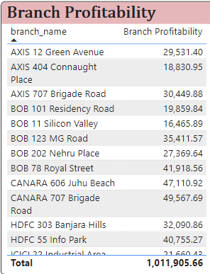
BRANCH PROFITABILITY
Key Insight:
Branch profitability is a critical metric that indicates how much revenue a branch generates from customer account balances.
Branches with higher profitability are key to the bank's financial health and success.
Recommendation:
Focus on optimizing high-profit branches by increasing customer engagement and services.
Identify low-performing branches and investigate ways to improve profitability, such as reducing operational costs or enhancing services.

Slide 4
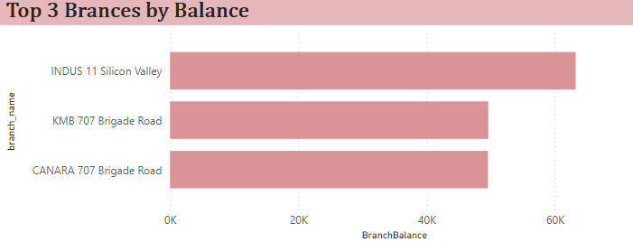
Top Three Branches by Total Account Balances
Key Insight:
This chart highlights the branches that have the highest total account balances, which directly correlates with profitability.
These branches are the most financially important for the bank.
Recommendation:
Strengthen customer relationships in top branches and implement strategies to increase their profitability even further.
Expand successful strategies from these branches to other areas to boost overall performance.

Slide 5
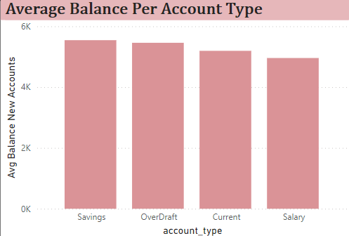
Average Balance for Each Account Type
Key Insight:
The average balance per account type provides valuable insights into customer wealth distribution across different account categories (e.g., savings, current, overdraft).
Savings and salary accounts generally hold higher balances, whereas overdraft accounts might indicate risk.
Recommendation:
Tailor marketing and financial products according to the account type that holds higher balances.
Consider adding more value or incentives to high-balance accounts to encourage further deposits and long-term relationships.

Slide 6
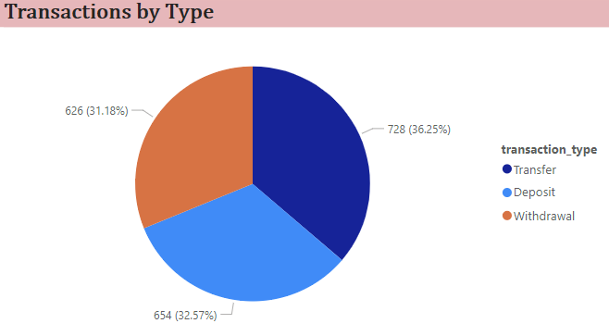
Total Number of Transactions by Transaction Type (Deposit, Withdrawal, Transfer)
Key Insight:
This chart provides a clear picture of the frequency of transaction types, offering insights into customer activity.
Higher transaction types like deposits show trust in the bank, while withdrawals and transfers indicate regular usage.
Recommendation:
Optimize systems and resources based on the most common transaction types.
Develop services that encourage more value-added transactions, such as higher-value transfers or deposits.

Slide 7
key Insights & Conclusion
Key Insights:
Branch Profitability: High-performing branches significantly contribute to the bank's financial strength. Optimizing these branches can lead to better profitability across the organization.
Top Branches by Account Balance: Identifying branches with the largest account balances allows the bank to focus resources on these high-value areas. Strengthening these branches' offerings will ensure sustained growth.
Account Type and Average Balance: Tailoring banking products to high-balance account types (e.g., savings and salary accounts) can enhance customer engagement and retention. Overdraft accounts may require targeted risk management strategies.
Transaction Behavior: Understanding transaction types and customer activity provides opportunities to streamline services, reduce operational costs, and increase customer satisfaction.
Conclusion:
This analysis of banking operations using Power BI has highlighted critical insights into branch performance, customer behavior, and transaction patterns. By focusing on branch profitability, top-performing accounts, and transaction trends, the bank can make informed, data-driven decisions to enhance operational efficiency, customer relationships, and overall profitability.

Slide 8
Next Steps :
Continue improving services in high-performing branches while addressing the needs of underperforming branches.
Leverage customer transaction and account data to develop personalized offerings.
Implement targeted strategies to reduce risks associated with overdraft accounts

Slide 9
Human resources slide 10
Thank You

